Slide 1
Form
Form Submission | Controlled Inputs | Multiple Inputs | Other Form Widgets
Notes:
Welcome to our lecture on Forms. In this lecture we will go through the form submission, controlled inputs, multiple inputs, and other form widgets. Let’s start the video lecture.

Slide 2
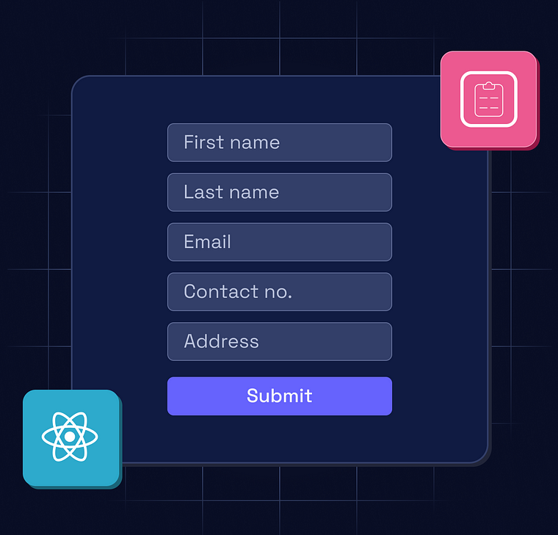
Creating a List
Handling Submission: The onSubmit attribute assigns a handler to process form submissions in React.
Prevent Default: The handler usually calls event.preventDefault() to stop the default page reload.
Processing Data: Submitted data can be sent to a web API or used to update the webpage dynamically.
Notes:
Now, let’s explore handling form submissions in React. The on Submit attribute assigns a function to manage form submissions. To prevent the default page, reload, event prevent Default is called inside the handler. Once submitted, the data can be processed, such as sending it to a web API or updating the webpage dynamically. This ensures smooth user interactions and efficient data handling.

Slide 3
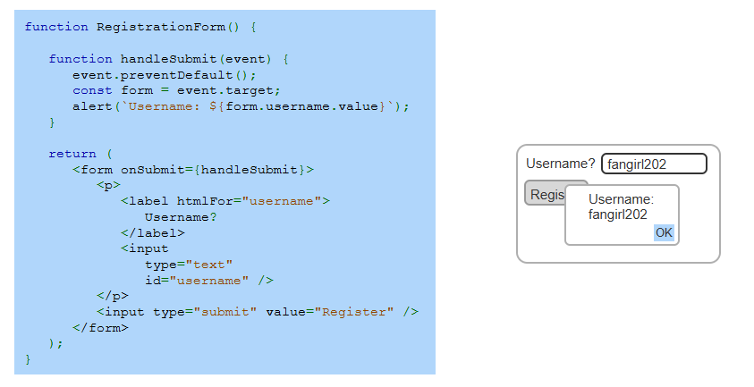
Example
Notes:
Let’s take a look at this example of form submission in React. The Registration Form component includes a handle Submit function that prevents the default page reload using event dot preventDefault. When the form is submitted, the entered username is accessed from event dot target and displayed in an alert. This approach ensures smooth form handling and prevents unnecessary page refreshes.

Slide 4
Controlled Input
Controlled vs. Uncontrolled: Controlled inputs have their state managed by React, while uncontrolled inputs manage their own state.
State Management: The useState() hook stores the input's value, keeping it in sync with React state.
Updating State: An onChange handler updates the state variable, which is then assigned to the input's value attribute.
Notes:
Now, let’s discuss controlled inputs in React. Controlled inputs have their state managed by React, while uncontrolled inputs manage their own state. The use State hook stores the input’s value, ensuring it stays in sync with React state. An on Change handler updates the state variable whenever the user types, and this updated state is assigned to the input’s value attribute for real-time control.

Slide 5
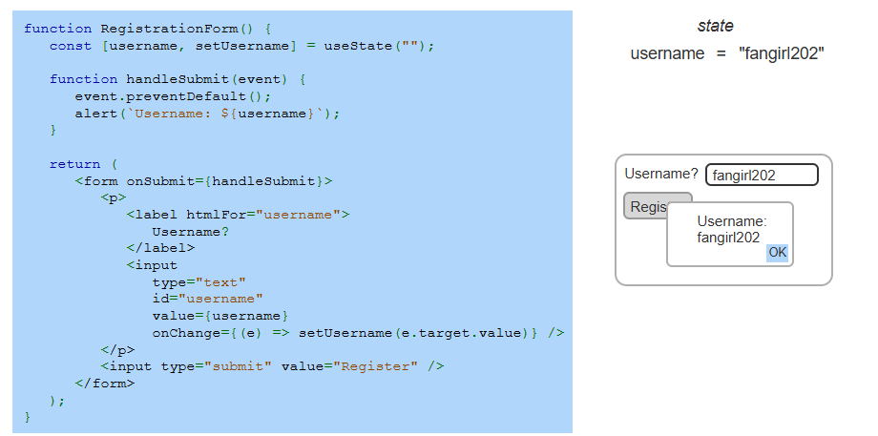
Example
Notes:
Let’s look at this example of a controlled input in React. The Registration Form component manages the username state using use State. The input field's value is controlled by this state and updates dynamically through the on-Change handler. When the form is submitted, the username is displayed in an alert. This ensures that React fully controls the input, keeping it in sync with state.

Slide 6
Multiple Input
Two Approaches: Manage multiple inputs with separate state variables or a single state object.
Efficient Strategy: Using a single state object reduces code but requires name attributes for inputs.
Handling Changes: A shared onChange handler updates the state object using setInputs().
Notes:
Now, let’s explore handling multiple inputs in React. There are two approaches: using separate state variables for each input or a single state object. The second approach reduces code but requires name attributes for inputs. A shared-on Change handler updates the state object using set Inputs, ensuring all input fields stay in sync and making form management more efficient.

Slide 7
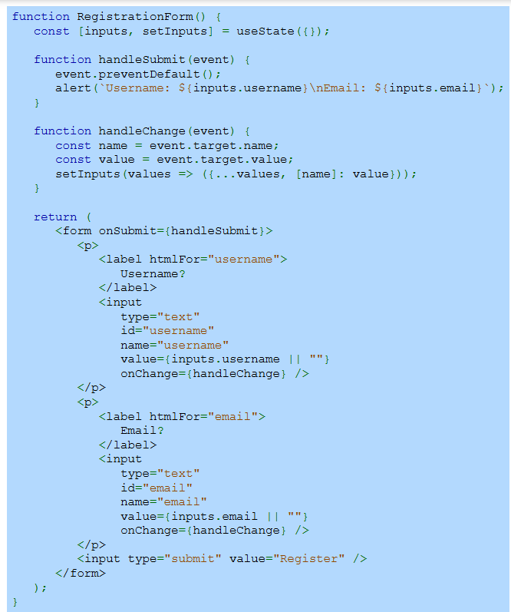
Example
Notes:
Let’s look at this example of handling multiple inputs in React. The Registration Form component manages multiple input fields using a single state object. The handle Change function updates the state dynamically based on the input’s name attribute. This approach keeps the code clean and ensures that all input values remain in sync, making form management more efficient and scalable.

Slide 8
Other Form Widgets
Controlled Form Widgets: Textareas, select dropdowns, and checkboxes can be controlled inputs in React.
Textarea & Select: The value attribute controls textareas and dropdowns, setting their selected or entered values.
Checkbox Handling: The checked property (Boolean) determines if a checkbox is selected instead of value.
State Management: useState() initializes default values, and handleChange() updates state using event.target.value or event.target.checked for checkboxes.
Notes:
Now, let’s explore other form widgets in React. Text areas, select dropdowns, and checkboxes can be controlled inputs. The value attribute manages text areas and selects, while checkboxes use the checked property. The use State hook initializes values, and handle Change updates state using event dot target dot value for inputs and event dot target dot checked for checkboxes, ensuring proper state management.

Slide 9
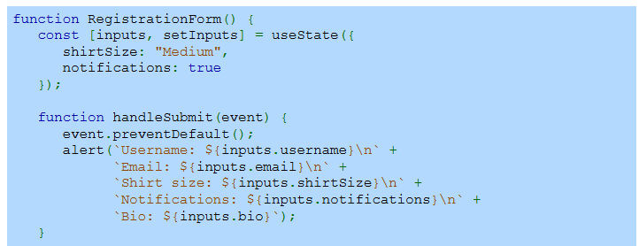
Example
Notes:
Now, let’s look at an example of handling multiple form inputs in React. The Registration Form component stores multiple input values in a single state object using use State. The handle Submit function prevents the default form submission and displays the stored values in an alert. This approach keeps all input fields managed under one state object, making the form more organized.

Slide 10
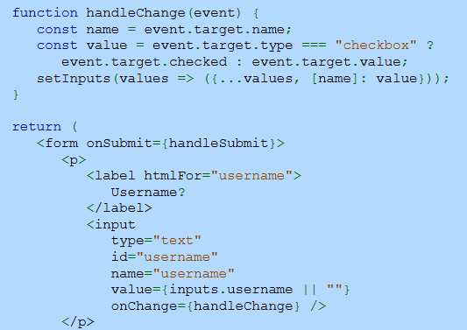
Example (Continue)
Notes:
Continuing with our example, let’s see how state updates dynamically. The handle Change function updates the state whenever an input field changes. It extracts the input’s name and value, then updates only that specific property in the state object. For checkboxes, event dot target dot checked is used instead of event dot target dot value. This ensures all inputs remain synchronized in the form.

Slide 11
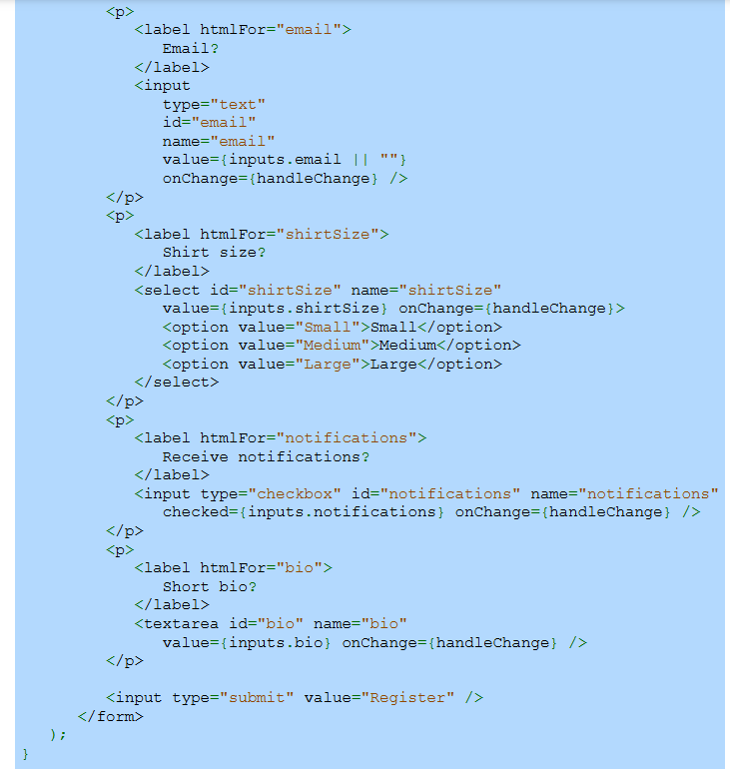
Example (Continue)
Notes:
Finally, let’s examine how various form elements are handled. The form includes a text input for email, a dropdown for shirt size, a checkbox for notifications, and a text area for the bio. Each input is controlled, with its value managed by React state. The form updates dynamically through handle Change, ensuring that user inputs are properly captured and stored in the state.

